Slide 1

Vivekanand Education Society’s Institute Of Technology
Department Of Information Technology
DSA mini Project
A.Y. 2024-25
Title: Bank Management System
Sustainability Goal : Efficient Resource Utilization
Domain: software development / Educational
Technologies
Group Members:
Member1 :
68 Atharva Chaudhari
Member2:
70 Yogita Patil
Member3:
71 Prajwal Kasbale
Mentor Name: Mrs.Kajal Jewani

Slide 2


Slide 3
Content
Introduction to the Project
Problem Statement
Objectives of the Project
Scope of the Project
Requirements of the System (Hardware, Software)
ER Diagram of the Proposed System
Data Structure & Concepts Used
Algorithm Explanation
Time and Space Complexity
Implementation
Gantt Chart
12. Test Cases 13.Challenges and Solutions
Future Scope
Code
Output Screenshots
Conclusion
References (in IEEE Format)

Slide 4
Introduction to Project
The Bank Management System is a C program designed to simulate real-world banking operations. It allows users to create, display, and delete accounts, as well as perform transactions like deposits and withdrawals while maintaining account balances. The system uses linked lists to store accounts and transactions, ensuring efficient dynamic data management. A queue structure manages transactions in a FIFO manner, keeping the order intact. Additionally, the program features persistent storage through binary files to save and retrieve data across sessions. With a password-protected interface and a user-friendly menu, the system provides secure and seamless banking functionality.

Slide 5
Problem Statement
Banking institutions need efficient systems to manage customer accounts, track
deposits and withdrawals, and maintain a record of each transaction.
The goal of this project is to develop a simple banking system that supports:
1.Creation and deletion of accounts. 2.Performing deposits and withdrawals. 3.Maintaining a queue of transaction records.
The problem requires the use of efficient data structures to ensure quick access,
update, and deletion of accounts, as well as storing transactions.

Slide 6
Objectives of the project
Account Management: Implement account creation, deletion, and display functionalities to
allow users to manage individual bank accounts seamlessly.
Transaction Handling: Record deposits and withdrawals while updating account balances to reflect accurate financial status.
Transaction Log: Implement a FIFO (First-In-First-Out) queue to maintain the chronological
order of transactions for better tracking and transparency.
Data Structure Use: Utilize linked lists for managing accounts and queues for transactions,
simulating real-world banking operations efficiently.
Persistent Data Storage: Save and load account and transaction data from binary files to
ensure data persistence across program executions.
Security and Access Control: Implement a password-protected login system to ensure
only authorized users can access the application.
User-Friendly Interface: Provide a color-coded menu-driven interface for better readability and ease of navigation.

Slide 7
Scope of The Project
Core Banking Functions
The project primarily focuses on the core functionalities of a banking system, including:
Account Creation: Users can create multiple accounts with unique account numbers and names.
Account Deletion: Users can delete accounts as per their requirements.
Account Management: Users can view account details, including balances.
Educational Purpose
The project serves as a practical learning tool for understanding:
Basic programming constructs in C.
Data structure implementations.
Software design principles.
Problem-solving and algorithmic thinking.

Slide 8
Requirements of the system (Hardware,
software)
Hardware Requirements:
Any personal computer capable of running a C compiler.
Minimum RAM of 1 GB.
Disk space: less than 50 MB for code and data files.
Software Requirements:
Operating System: Windows, Linux, or MacOS.
Compiler: GCC or any C compiler.
IDE: Code::Blocks, Dev-C++, or Visual Studio Code.
Libraries:
stdio.h: For input/output operations.
stdlib.h: For dynamic memory allocation and process control.
string.h: For string manipulation functions.

Slide 9
Data Structure and Concept Used
The code implements a basic banking system using the following data structures and concepts:
DATA STRUCTURES: -
Account (Linked List):
Stores account details (account_number, name, balance) in a singly linked list.
Transaction (Linked List):
Records transactions (deposit/withdraw) with account_number, amount, and type, also in a linked list.
TransactionQueue (Queue):
Manages transactions in a FIFO manner using pointers to the front and rear of the transaction list.
BinaryFiles(PersistentStorage):
Binary files (accounts.dat and transactions.dat) are used as a crucial data structure for persistent storage, ensuring that all account and transaction data is saved and retrievable across program executions. This allows the system to maintain continuity and data integrity even after the program exits.

Slide 10
Data Structures and Concept Used
CONCEPTS USED:
Linked List Usage in Code:
Account List:
The struct Account is implemented as a singly linked list to store account details.
Each account node contains an account_number, name, balance, and a pointer next that links it to the next account in the list.
Transaction List:
The struct Transaction is also implemented as a singly linked list. Each transaction node stores details like account_number,
amount, type (Deposit/Withdraw), and a pointer next for linking to the next transaction.
Queue (FIFO)
Usage in Code:
The struct TransactionQueue is implemented to manage transactions in a First-In-First-Out (FIFO) manner.
The front pointer refers to the first transaction in the queue, while the rear pointer refers to the last transaction.
Transactions are added to the rear and removed from the front, ensuring that the oldest transaction is always processed first. This is critical for maintaining transaction order.
Persistent Storage (Binary Files)
Usage in Code:
Binary files (accounts.dat and transactions.dat) are used to store account and transaction data persistently.
Functions like saveAccounts and saveTransactions write data to files, while loadAccounts and loadTransactions retrieve data. This ensures that
account and transaction records are not lost when the program exits.

Slide 11
Data Structures and Concept Used
Dynamic Memory Allocation
Usage in Code:
The malloc function is used to allocate memory dynamically for new accounts and transactions.
This approach enables efficient memory usage, as memory is allocated only when new accounts or transactions are
added.
Password Protection
Usage in Code:
A password system is implemented to restrict access to authorized users.
The user is prompted to enter a password, and access is granted only if the entered password matches the predefined
value.
Modular Programming
Usage in Code:
The program is organized into multiple functions, each handling a specific task such as account creation, transaction processing, or data
persistence.
This modular structure improves code readability, maintainability, and reusability.
User-Friendly Interface
Usage in Code:
The use of ANSI escape codes provides a color-coded text interface, making it more intuitive for users.
A menu-driven system ensures easy navigation through functionalities like creating accounts, depositing, withdrawing, and viewing transactions.
Error messages (e.g., "Account not found" or "Insufficient balance") are displayed for incorrect operations.

Slide 12
Algorithm Explanation
Algorithm Explanation:
STEP 1: Initialization:
Load accounts and transactions from binary files into memory using linked lists and a queue.
STEP2: Password Verification:
Prompt user for password; allow access only if it matches the predefined password.
STEP3: Main Menu:
Display options: Create Account, Display Account, Delete Account, Deposit, Withdraw, Display Transactions, Exit.
STEP4: Option Handling:
Create Account: Generate account number, add to the account list, and save to file.
Display Account: Search the linked list and display account details.
Delete Account: Remove account from the list, free memory, and update the file. Deposit/Withdraw: Update balance, enqueue a transaction, and save data to files. Display Transactions: Traverse the transaction queue and show all transactions. Exit: Save all data and terminate
.
STEP5: Data Persistence:
Save updates to binary files after every operation to ensure data integrity.

Slide 13
Time Complexity
Time Complexity:
𝑂(𝑛),O(n) for account operations (create, display, delete, deposit, withdraw), and
𝑂(𝑚),O(m) for displaying transactions, where 𝑛 , n is the number of accounts and 𝑚 ,m is
the number of transactions.
Space Complexity:
𝑂(𝑛+𝑚) ,O(n+m) due to storing 𝑛 ,n accounts and 𝑚,m transactions in linked lists, plus additional space for function call overhead.

Slide 14
Implementation
This Bank Management System in C uses a linked list to manage accounts and transactions, stored persistently in binary files (accounts.dat and transactions.dat). It supports creating, displaying, and deleting accounts, as well as depositing and withdrawing money, while recording transactions in a queue. The program includes color-coded outputs for better user interaction and password protection for access. Features like unique account number generation, file-saving mechanisms, and a menu-driven interface ensure a smooth and secure banking experience, with all data safely stored and accessible across sessions.

Slide 15
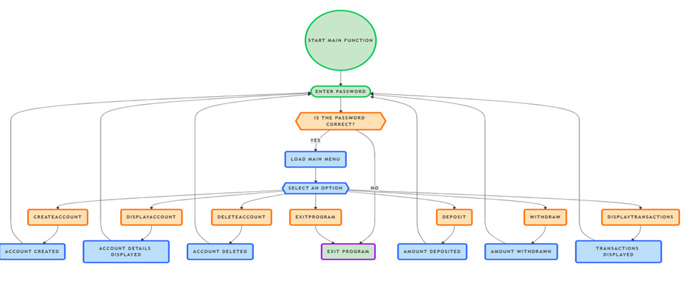
Flow Chart

Slide 16
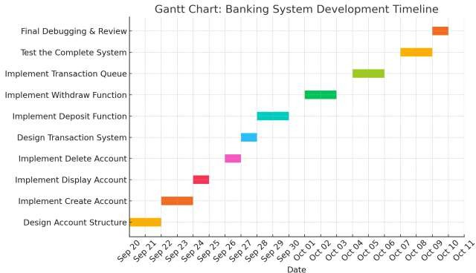
Gannt Chart

Slide 17
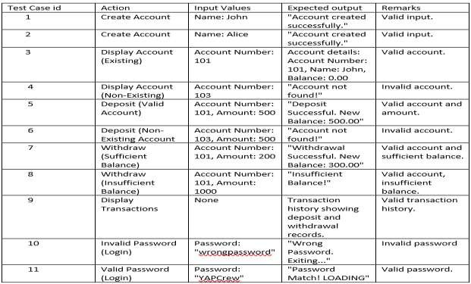
Test Cases

Slide 18
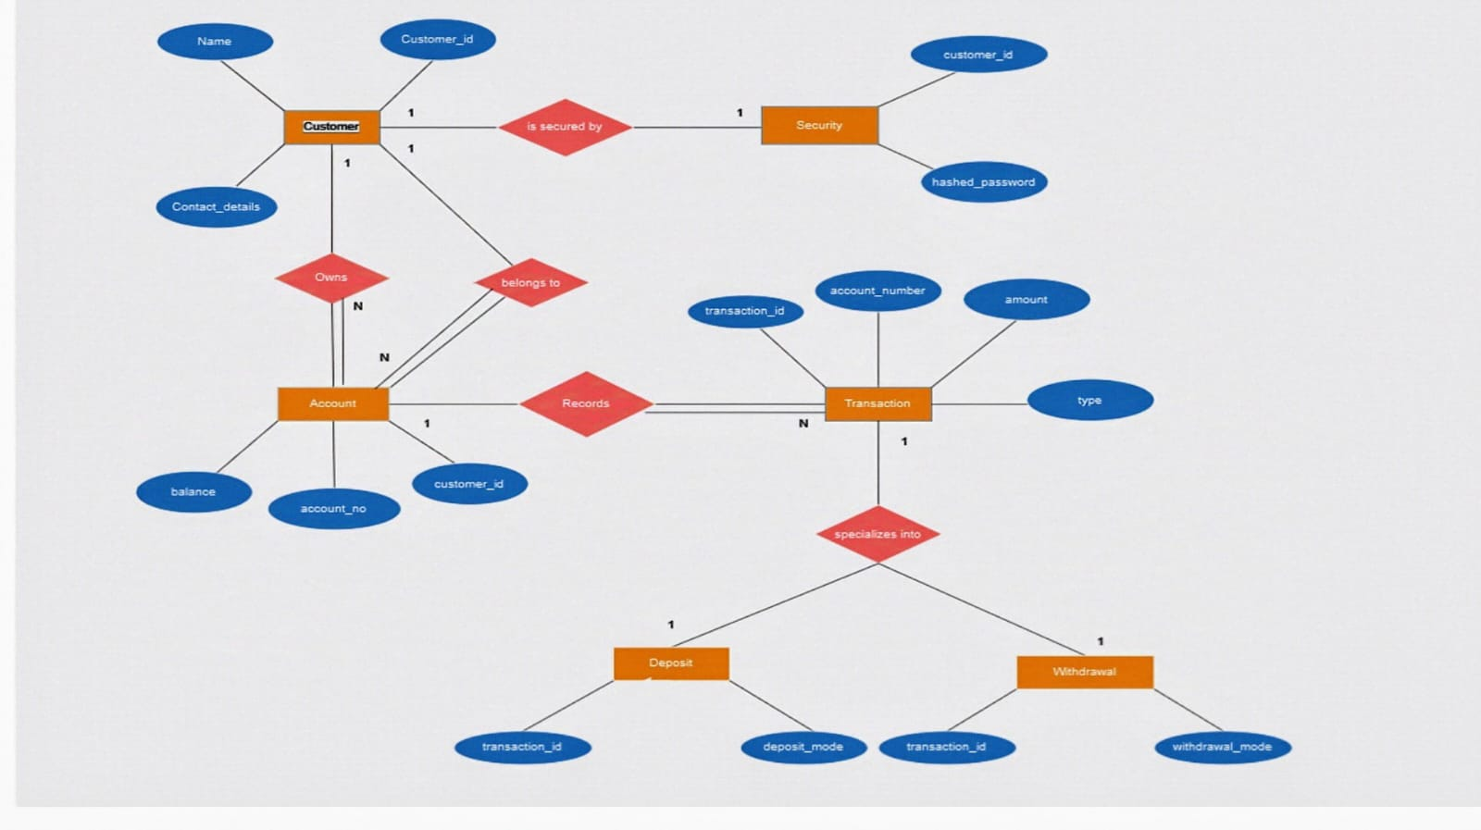
ER diagram of the proposed system

Slide 19
Challenges and Solutions
Dynamic Memory Management
Challenge: Managing dynamic memory allocation for accounts and transactions can lead to memory leaks if memory is not
correctly freed.
Solution: Ensure that every dynamically allocated memory (via malloc) is freed properly when it's no longer needed. For example,
after deleting an account or when exiting the program, free the associated memory to avoid memory leaks.
Handling Invalid Input
Challenge: Users may provide invalid input such as non-numeric characters for account numbers or negative deposit amounts.
Solution: Add input validation checks for all user inputs. Use scanf return values to detect incorrect input and handle errors
gracefully. For numeric inputs like account_number or amount, ensure the values are positive and within acceptable limits.
Handling Non-Existent Accounts
Challenge: Users might attempt to deposit, withdraw, or display transactions for an account that doesn’t exist.
Solution: Before performing any operations like deposit, withdraw, or display, check if the account exists by traversing the linked list of accounts. If the account isn’t found, provide a user-friendly message like "Account not found!" and skip the operation.

Slide 20
Future Scope
Persistent Storage Integration: Expand the system by adding file handling or database support to store
account and transaction data permanently, allowing data retrieval across program restarts.
Enhanced Security & Authentication: Implement user authentication (e.g., passwords or PINs) and
encryption to secure sensitive data, enhancing the system's security for multi-user environments.
Advanced Features: Introduce features like interest calculation, account transfers, and loan management to offer more comprehensive banking functionality.

Slide 21
Code
Code Link

Slide 22
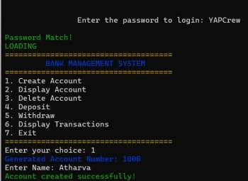
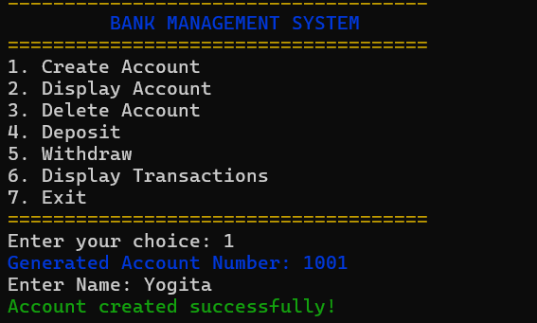
Code Output:-
1. CREATION OF ACCOUNT:-

Slide 23
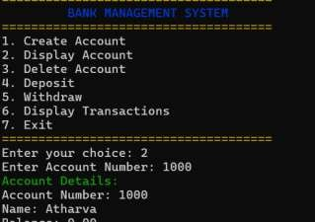
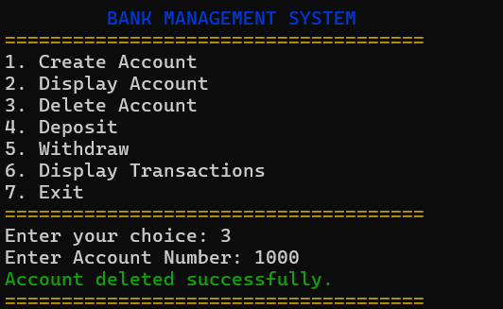
Code Output:-
2. DISPLAY OF ACCOUNT:-
3. DELETION OF ACCOUNT:-

Slide 24
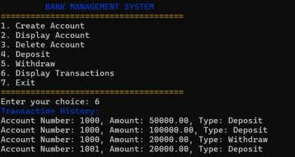
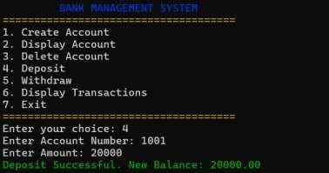
Code Output
4. DEPOSIT OF ACCOUNT:-
5. DISPLAY TRANSACTIONS :-

Slide 25
Literature Survey and Review
1) Article Name: Bank Management System
Literature Survey:
Anju Dagar discusses the importance, advantages, and challenges of online banking, focusing on its role in driving global competition and its impact on financial systems. Muhammad Abdus Sattar Titu and Md. Azizur Rahman highlight the major online banking services in Bangladesh, customer satisfaction, and the issues encountered during banking transactions.
Review:
The article emphasizes the security and efficiency of online banking systems, addressing transaction issues and customer concerns. It proposes a secure and automated banking
environment, ensuring accuracy and reducing human errors in transactions.
2) Article Name: Bank Management System
Authors: C. Geetha, Srikanth, Sai Kumar
Published in: International Journal of Modern Agriculture, Volume 9, No. 4, 2020
ISSN: 2305-7246
Literature Survey:
The paper references the use of Information and Communication Technology (ICT) in banking systems, which has intensified global competition and increased the importance of financial institutions in economic development .It also addresses the security measures required in banking systems, including the need for authentication and fraud prevention .
Review: The article discusses the integration of ICT in banking, highlighting the advantages of automation and the reduced need for manual work in financial transactions. 2. It emphasizes security features like authentication systems and fraud prevention measures, making banking transactions safer and more efficient.

Slide 26
Literature Survey and Review
3) Article Title: Bank Management System
Published in: International Journal of Engineering Research in Computer Science and Engineering (IJERCSE), Vol 8, Issue 8, August 2021
Literature Survey / Related Work
Information and Communication Technology (ICT) in Banking: The study in this paper highlights the importance of ICT in driving competition globally and how Service-Oriented Architecture (SOA) is being used by banks such as Scandinavian and Swiss banks for improved customer service.
Transaction Risks and Security: The paper discusses transaction risks that arise due to weak legal enforcement in some regions and how it affects banking operations. It also
emphasizes the critical role of security in banking systems, suggesting methods to improve security, such as adding security questions for account login.
Review:
The paper addresses both the security and operational challenges in modern banking systems, using ICT and SOA to enhance service delivery while ensuring secure and reliable
transactions for customers. This makes the banking experience more efficient and secure for users, reducing manual errors and improving overall service.
4) Article: Bank Account Management System Authors: Md. Jasim Uddin & Md. Nuruzzaman Date: June 2015
Literature Survey:
Banking Systems and Automation:
Many researchers have emphasized the need for automating banking systems to reduce manual errors and improve efficiency. Automated banking solutions, such as the Bank Account
Management System, have been studied in various contexts to address customer needs, transaction processing, and account management more effectively.
Database Management in Banking Applications:
Several studies have highlighted the role of database management systems (DBMS) in ensuring smooth banking operations. These systems handle complex transactions and maintain data integrity, which is critical for bank account management systems like the one described in this paper.
Review:
The article discusses the development of a Bank Account Management System, focusing on how it can automate and streamline banking operations. The project aims to enhance efficiency and security in account management processes, with practical applications for real-world banking scenarios.

Slide 27
Conclusion
Effective Management: The project successfully implements a linked list structure to manage accounts and transactions, allowing for efficient creation, deletion, and display of account details, which enhances user experience and functionality.
Transaction Tracking: By utilizing a queue for transactions, the system efficiently tracks deposits and withdrawals, ensuring accurate financial records are maintained, which is crucial for any banking or financial application.
Modular Design: The code demonstrates a modular approach, with separate functions for each operation (account management and transaction processing), improving maintainability and scalability of the application for future enhancements or integrations.

Slide 28
References
1. M. Jasim Uddin and M. Nuruzzaman, "Bank Account Management System," Final Year Project Report, City University,Dhaka,Bangladesh,June2015.[Online].Available:https://www.researchgate.net/publication/301293322. [Accessed: Dec. 5, 2024].
2. A. Siddika, "Project Supervision for Bank Account Management System," Department of Computer Science &
Engineering, City University, Dhaka, Bangladesh, June 2015.
M. Jasim Uddin and M. Nuruzzaman, "Final Year Project on Banking Systems," Department of Computer Science
& Engineering, City University, Dhaka, Bangladesh, 2015.
S. Kumar and R. Sharma, "Automated Banking Systems: Trends and Future Prospects," Journal of Banking
Technology, vol. 32, no. 3, pp. 45-56, Mar. 2017.
S. A. Smith, "Database Management Systems in Banking," International Journal of Computer Science and
Applications, vol. 24, no. 5, pp. 231-245, Nov. 2016.
R. Ghosh, "A Comparative Study of Transaction Management in Online Banking Systems," International Journal
of Internet Computing, vol. 22, no. 4, pp. 12-25, Apr. 2018.

